Slide 1
Phased Retirement Unpacked
Presented by
Talana Bell, Kimberly Ladenthin
Cindy McGuire, and Stephanie Ramsey

Slide 2
Phased Retirement
Developed by the UNC System for eligible full-time tenured faculty members to transition to retirement
Half-time or equivalent service for maximum of 3 years
Goals of phased retirement
Promote renewal of professoriate to ensure institutional vitality
Provide additional flexibility and support for faculty members nearing retirement
Voluntary (participant can terminate with mutual agreement of both parties)
Notes:
Talana

Slide 3
Who is Eligible?
Full-time tenured faculty members at the time of application.
At least five years of full-time service at AppState.
Eligible to receive retirement benefits through either TSERS or the ORP and
62 years or older (TSERS); or
59 ½ or older (ORP)
Applicant's age and service longevity confirmed as of August 1 following submission of an application for participation. For this year, it is August 1, 2025.
Notes:
Talana

Slide 4
Who is NOT Eligible?
Non-tenure track faculty
Tenure track faculty who have not attained tenure as of the application date
Faculty occupying administrative positions unless they vacate the administrative or staff position
Notes:
Talana

Slide 5
Eligibility Examples
Tenured Associate Professor birthdate of July 31, 1963, and hire date of August 1, 2020
Tenured faculty member
As of 8/1/2025, age is 62 and years of service are 5
Eligible under TSERS and ORP
Assume same facts above except Associate Professor is non-tenured, but plans to apply for tenure during the 2024-2025 academic year
Non-tenured at the time of application
As of 8/1/2025, age is 62 and years of service are 5
Not Eligible
Notes:
Talana

Slide 6
Eligibility Examples (cont.)
Tenured Professor with birthdate of August 2, 1963, and hire date of August 1, 2020
Tenured faculty member
As of 8/1/2025, age is 61 with 5 years of service
Not Eligible under TSERS
Eligible under ORP
Tenured Professor with birthdate of June 3, 1959, and hire date of August 15, 2020
Tenured faculty member
As of 8/1/2025, age is 66 with 4 years of service
Not Eligible
Notes:
Talana

Slide 7
Am I Guaranteed to be Accepted in the Phased Retirement Program if I am Eligible?
Eligible Faculty Members do not have an absolute right to participate in the Program. Rather, departments, schools or the University may limit participation in the Program based on various conditions:
Finding that financial exigencies prohibit enrollment in the Program
Further enrollment in the Program will substantially weaken academic quality or disrupt program sequence
Department, school or University may establish a cap or limit on the number of Eligible Faculty Members who may enter the Program.
Notes:
Talana

Slide 8
Benefits
Effective date is July 1, 2025
Salary is 50% of full-time base salary received immediately prior to phased retirement (e.g., based on the Faculty Member's prior nine- or twelve-month contractual term, as applicable)
Compensation paid during phased retirement is paid over twelve (12) months regardless of the pattern of duties under the Faculty Member's work plan
Subject to any limitations imposed under the State Retirement System and the legislative appropriations process, Participating Faculty Members are eligible for salary increases and merit pay in subsequent years (not during the 1st year) of Program participation based on annual evaluations
Notes:
Cindy

Slide 9
Health Insurance During Phased Retirement
Health insurance benefits will continue, PROVIDED you choose to receive a monthly benefit from your retirement carrier (TSERS or ORP), who can advise you on the minimum and maximum monthly amounts.
Your plan coverage converts from Appalachian State University’s policy to the state retiree health group
Non-Medicare eligible
Auto enrolled in plan prior to entering Phased Retirement (70/30 or 80/20)
Benefits remain the same - only have to meet one deductible per fiscal year
Medicare eligible (65 or older)
Placed in Medicare Advantage Plan – administered by Humana
Any covered dependents who are Medicare-eligible will also be mapped to Medicare Advantage Plan
Must elect Medicare Part B
The State Medical Plan will remain as your primary payer for all claims until you reach age 65. At age 65, Medicare becomes your primary coverage, and the State Medical Plan becomes secondary.
Notes:
Cindy

Slide 10
Cost of Health Insurance in Phased Retirement
If you were hired prior to October 1, 2006, your retiree health insurance is free
If you were hired after October 1, 2006, and have worked more than 10 years, but less than 20 years you must pay 50% of your health care premium
If you work 20 or more years, the retiree health plan is free.
If you have worked 10 years or less, then you must pay 100% of your health care premium.
Notes:
Cindy

Slide 11
Supplemental Benefits During Phased Retirement
Eligible Faculty Members participating in the Program are eligible to participate in the following employee benefit plans or programs:
Participation in all NCFlex supplemental benefit plans
Continued participation in any supplemental retirement plans (401(k), 403(b), 457)
Deductions to the NC State Employee’s Credit Union
Notes:
Cindy

Slide 12
University Specific Benefits During Phased Retirement
Retain professorial rank
Professional liability insurance
Retain University Email Account
University Library privileges
Parking permit at half price
20% discount for REGULAR season (only) athletic tickets (not for individual games or for post–season contests).
Free access to University Recreation facilities (Mt. Mitchell, Quinn, and Student Recreation Center)
Office space, if teaching
Notes:
Cindy

Slide 13
Additional Terms and Conditions
Eligible Faculty Members give up tenure in the Program
Retain professorial rank and full range of responsibilities, rights, and general benefits associated with it, except for tenured status or as otherwise modified pursuant to an Eligible Faculty Member’s agreed-to "work plan”
May not serve on committees that require members be tenured
Maintain same academic freedoms and responsibilities as other faculty members
Maintain access to all grievance and appeal procedures normally available
Terminate full-time employment and contract for a period of half-time (or equivalent) service to the University
Half-time responsibilities may vary by department
Participants can work no more than .75 FTE and work no more than 30 hours in any given semester
Due to the Affordable Care Act, it is not permissible to work 1 FTE for one semester and 0 FTE for the other semester unless you wish to lose your health benefits and pay more for less.
Notes:
Talana
UNC Policy says you can do all in one semester, but as Cindy has stated, your benefits will radically change. Your choice.

Slide 14
Additional Terms and Conditions (cont.)
Maintain high levels of professional commitment to AppState
Remain subject to The Code and Policies of The University of NC and AppState
AppState may place a Participating Faculty Member on temporary leave with pay and/or reassign a Participating Faculty Member's duties
During or as a result of any investigation or disciplinary action
Invoked only in exceptional circumstances when the Participating Faculty Member’s department or division head determines that such action is in the best interests of AppState
Program does not provide a Participating Faculty Member with greater rights, claims or privileges
Notes:
Talana

Slide 15
What Steps Do I Take To Apply?
Discuss with your department chair your intentions of pursuing phased retirement
Determine “work plan” with department or division head detailing the half-time responsibilities (to be included in Agreement)
Teaching, research and service assignments during phased retirement period
Obtain approval of department/division head and applicable personnel committee
Submit the Application via Google Forms no later than January 10, 2025, noting that the work plan must be submitted within the application
Provost will approve or deny the application
Notes:
Talana

Slide 16
After Approval of the Application
The Reemployment Agreement and Release document will be drafted
The Reemployment Agreement is signed first by the appropriate administrators via DocuSign (YOUR signature will be the last obtained)
The Release form and instructions will be delivered to you by email at the time the Reemployment Agreement is sent for approvals
You will have forty-five (45) days to consider the Reemployment Agreement and Release document
It is at this point that the decision to continue is up to you
Carefully review the terms (consider consulting an attorney) and execute the Reemployment Agreement and Release document within 45 days of receipt of the approved Reemployment Agreement in DocuSign
Sign the Reemployment Agreement via DocuSign; sign the Release document and have it notarized
Deliver the notarized Release document to Kimberly Ladenthin in Academic Affairs in person or by US/campus mail
You have the right under ADEA to revoke the Reemployment Agreement and Release document within seven (7) calendar days of the date both documents are fully executed by all parties
Once the 7-day revocation period passes, the election to enter Phased Retirement is final
Make an appointment with the HR Office in March to initiate retirement paperwork
Notes:
Talana
ADEA – Age Discrimination in Employment Act

Slide 17
Revocation Procedures
Revocations must be in writing and personally signed by you
You must personally deliver or mail the revocation using United States Postal Service to the office or official to whom the prior application had been submitted
Email is NOT an acceptable revocation notice
If you elect to revoke the Reemployment Agreement and Release document within the 7-day revocation period, both agreements are void
In such circumstances, you will continue in your same full-time employment status as you held immediately prior to the execution of the Release document
Notes:
Talana

Slide 18
Frequently Asked Questions

Slide 19
Am I Required to Receive a Monthly Retirement Benefit From My Retirement Carrier to Participate in the Program?
You are not required to receive benefits under TSERS or ORP
However, you will not receive University-paid State Health Plan benefits
Notes:
Cindy

Slide 20
What happens when I turn 65?
You will be placed in Medicare Advantage Plan – administered by Humana
Medicare becomes your primary coverage, and the State Medical Plan becomes secondary
AS A PHASED RETIREE YOU MUST ELECT MEDICARE PART B WHEN YOU TURN AGE 65. Please contact Social Security to complete this enrollment. The closest Social Security Offices are located in Wilkesboro and Hickory
YOU DO NOT NEED TO ELECT MEDICARE PART D as the prescription drug benefits through the State Medical Plan are considered to be better than those offered by Medicare
Notes:
Cindy

Slide 21
Can I Begin Phased Retirement In January Instead of July?
No, unfortunately, you must enter Phased Retirement in July (beginning of the fiscal year)
The reason is to align the academic needs of AppState and to ensure proper coverage for course loads
Notes:
Talana

Slide 22
What if I decide I want to fully retire after I begin Phased Retirement?
Since the program is voluntary, you can terminate the Agreement as long as all parties agree to terminate. However, you will not be reinstated to your faculty role prior to the effective date of the Agreement.
Notes:
Talana

Slide 23
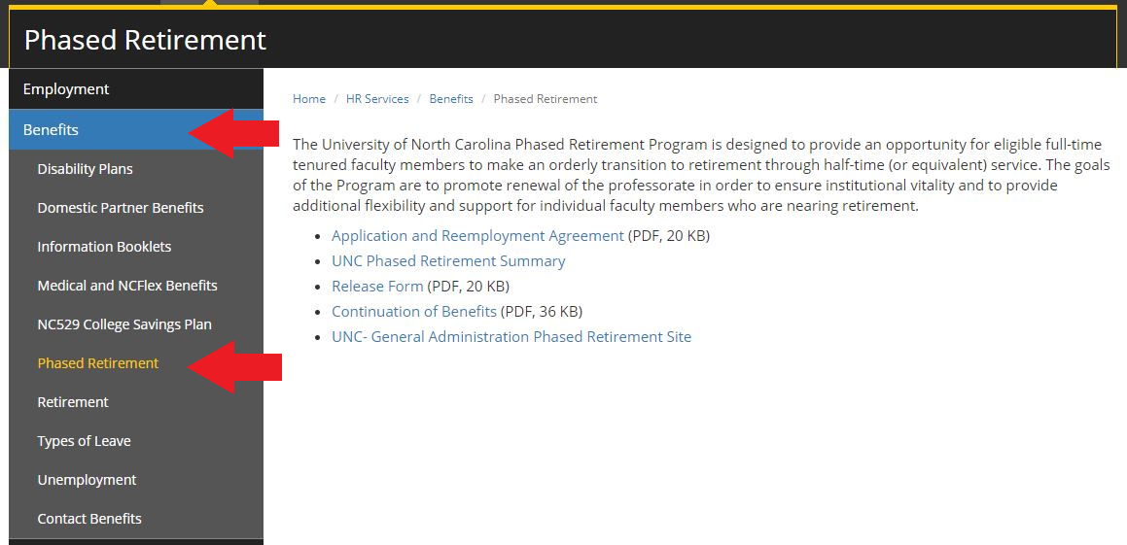
Where can I find more information and forms?
Refer to HR’s website below
https://hr.appstate.edu/hr-services/benefits/phased-retirement
You can also reference The Code and UNC Policy Manual, Chapter 300, section 300.7.2
Notes:
Cindy

Slide 24
I plan to apply for tenure in this academic year and am 63 years old with 9 years experience. Can I elect to take Phased Retirement?
No. Only tenured faculty are eligible for Phased Retirement. Since the faculty member is not tenured at the time of application (Fall semester 2024), they would not be eligible in this academic year. However, if the faculty member attains tenure during the 2024-2025 academic year (to take effect July 1, 2025), they can apply for Phased Retirement during Fall semester 2025 for an effective date of July 1, 2026.
Notes:
Talana

Slide 25
Questions ???

Slide 26
Thank You!

